Slide 1
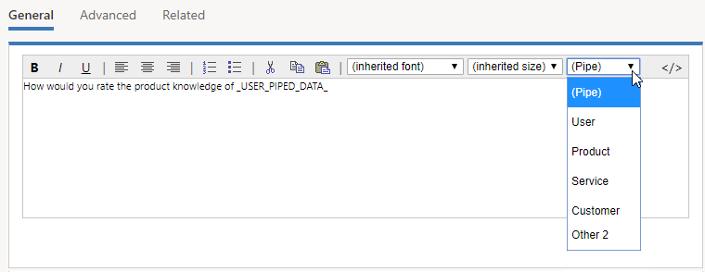

Slide 2
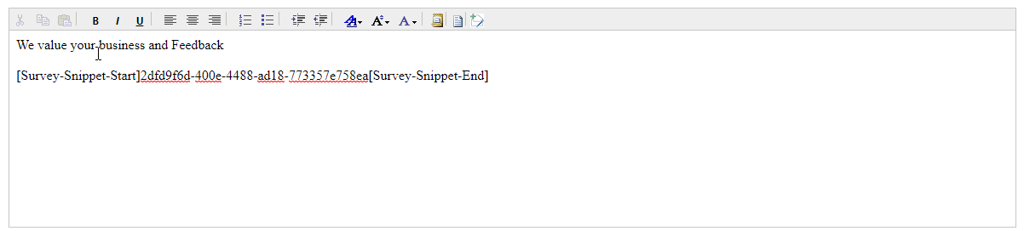
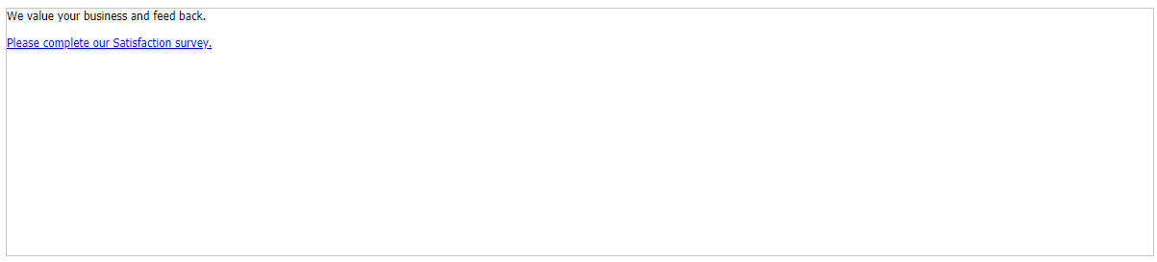
This is what an email containing the survey snippet looks like before sending.
Survey snippet replaced with link containing text defined in the survey link text.
This is what the respondent will see when they receive the survey invitation.

Slide 3
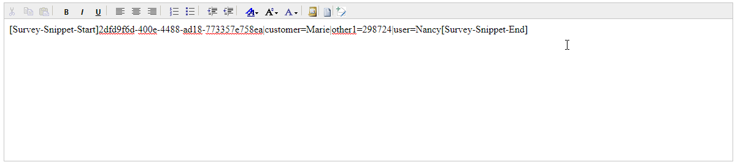
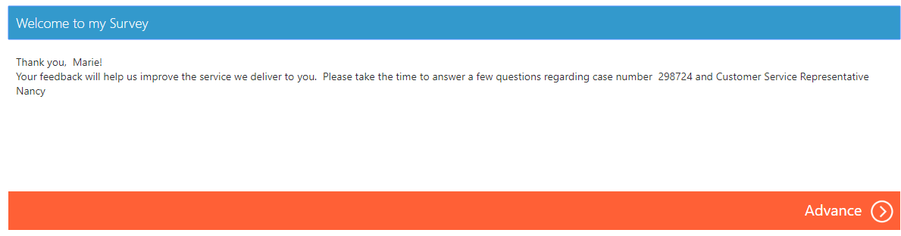
Defines the specific values to use for each of the piped data place holders used in the survey
Values replaced at runtime of the survey.

Slide 4
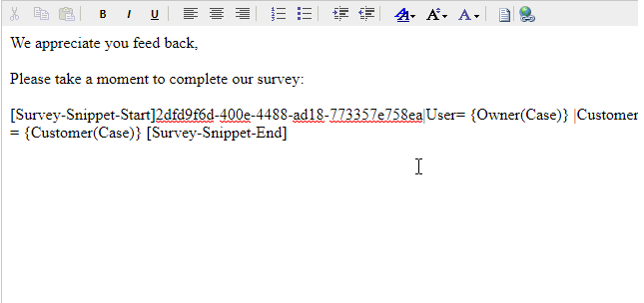
User value will be populated based on the owner of the associated case.
Customer value will be populated based on the customer record associated with a case.

Slide 5
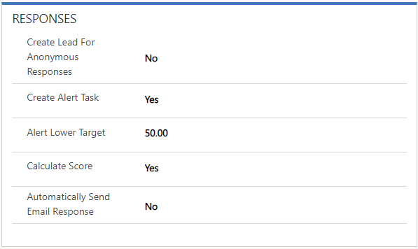

Slide 6
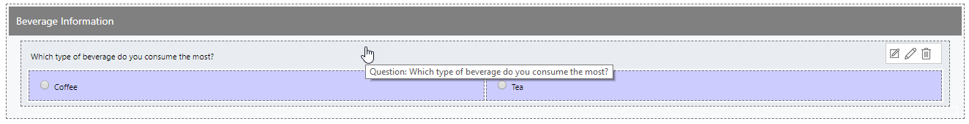
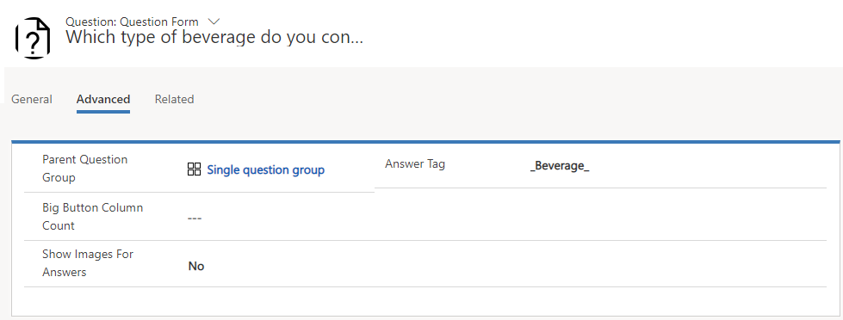
Answer tags must start and end with an underscore and cannot exceed 100 characters.

Slide 7
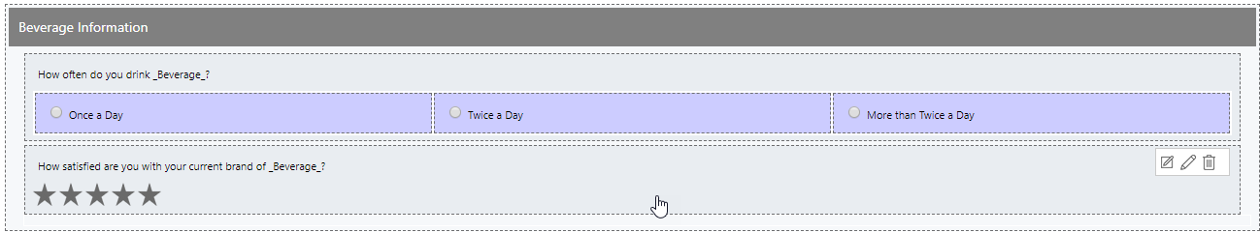
Tag can be added to question text of any question that needs to consume it.

Slide 8
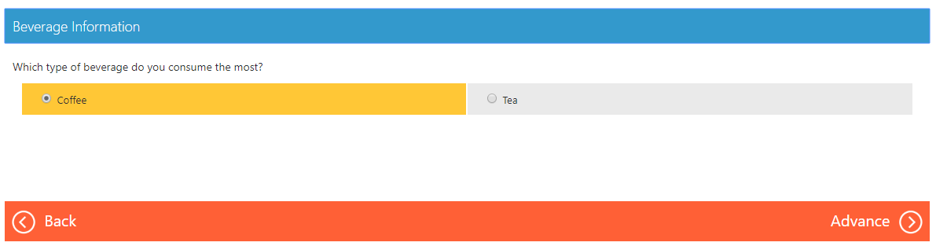
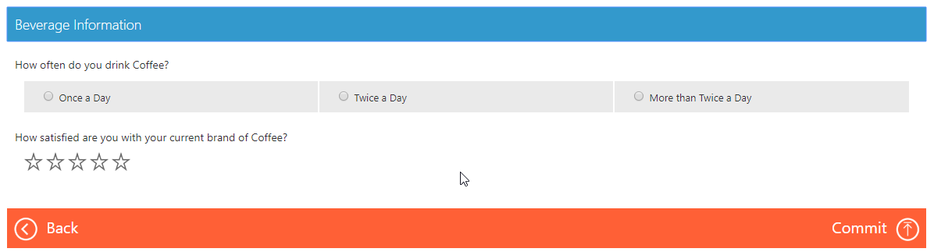
Response value captured and stored in the answer tag.
Value replace at survey run-time for any question that references the answer tag.

Slide 9


Products Survey Page
Windows, Azure, & Office queue
Please select all the products you would be interested in learning about.
Windows
Azure
Office
Yes
Dynamics
Are you interested in learning more about our products an services
Thank you for completing our survey!
Which Dynamics products?
Sales
Yes
No
Service
F&O
Dynamics Survey Page
Dynamics 365 queue
No

Slide 10
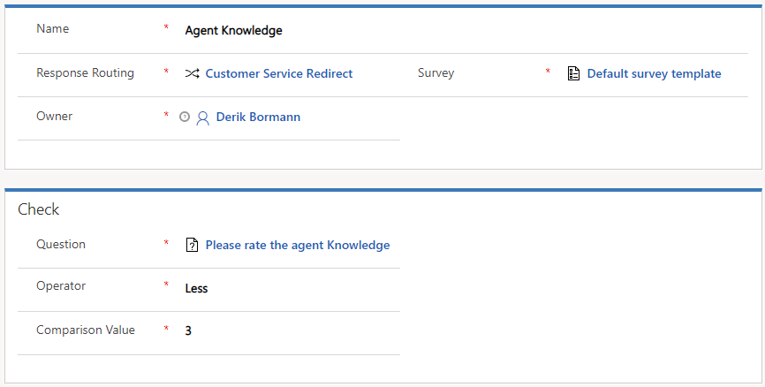

Slide 11
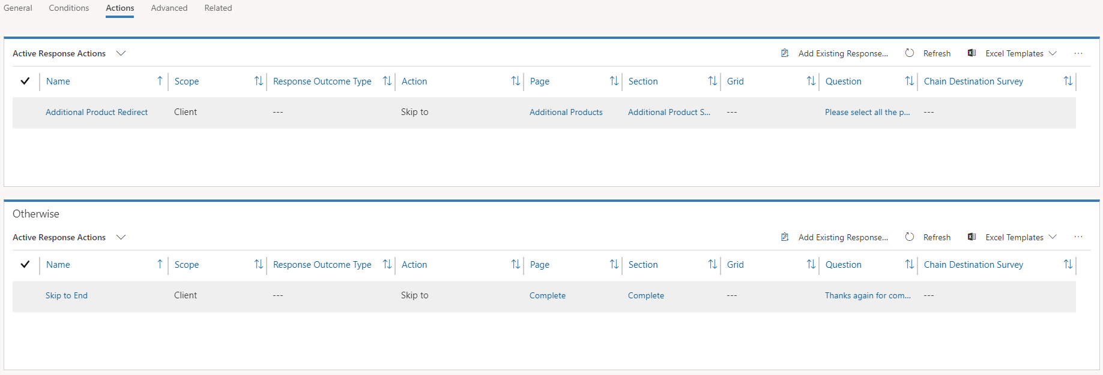
Defines the actions that will be executed if the specified condition is true.
Defines the actions that will be executed if the specified condition is false.

Slide 12
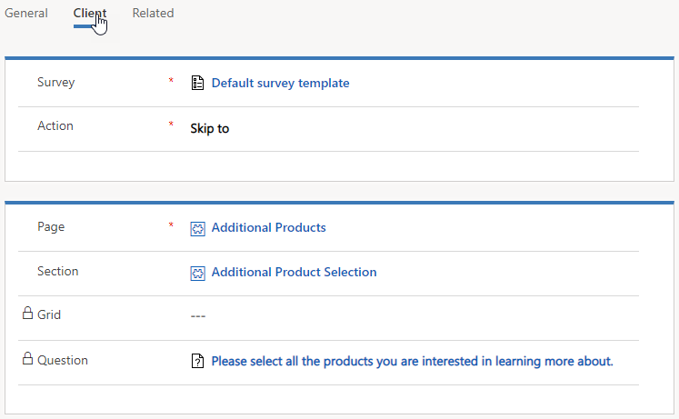

Slide 13
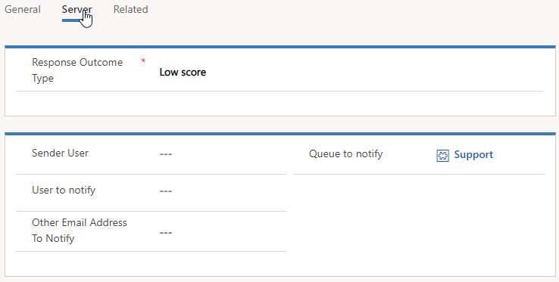

Slide 14
